Slide 1
I’mbesideyou Evaluation Task
Name: Suraj Kumar
Institute: IIT Dhanbad
Department: Software Engineer

Slide 2
System Design
System design of any application is based on the function it provides.
Here I am designing a chat app with following functionality:
User Authentication’
One to One Chat
Group Chat
Online Status
Notification
Sharing Multimedia
So let’s start looking into these one by one…

Slide 3
Let’s create the API endpoints;
1) Send_message(): (sender_userID, receiver_userID, text)
2) Get_message(): (user_ID,screen_size,before_timestamp)
The get and send messages are based on client’s perspective.
Services:
1)Messaging Service
2) Session Service
3) Relay Service
4)Last Seen Service
5) Asset Service
6) Group Chat Service

Slide 4
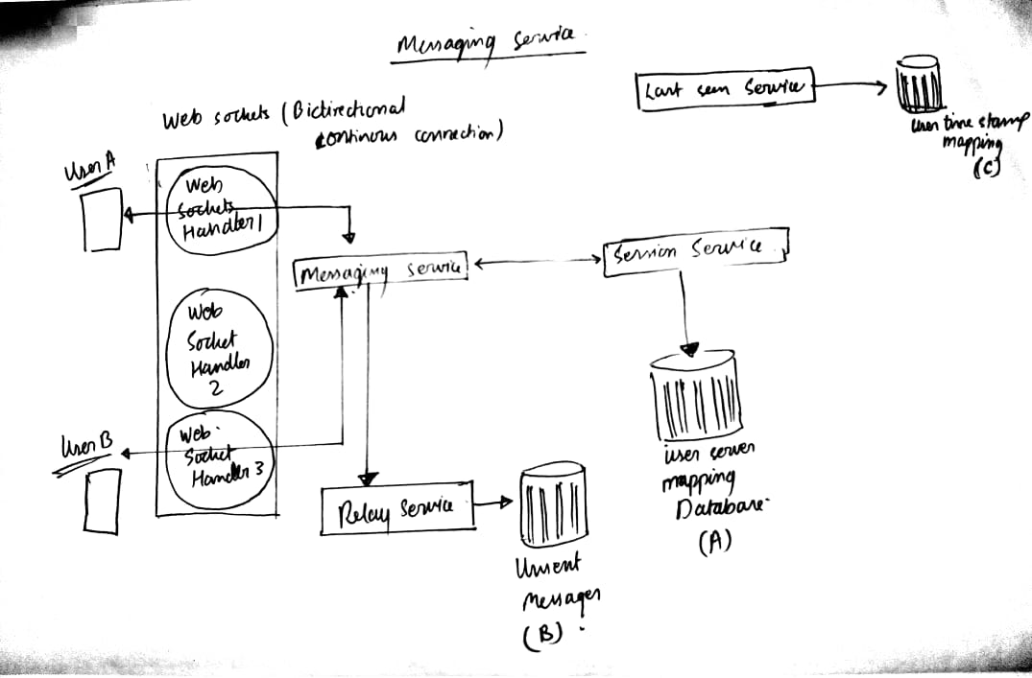

Slide 5
Suppose User A sends some message to user B using user B id. It connects through webSocket handler to messaging service, which then looks for the Server to which User B is connected using Session service.
The session service manages a database storing the mapping of user and the server to which they are connected.
If the User is online the message is delivered to the User B. Else:
We use Relay Service, that stores the message in specified schema in a database.

Slide 6
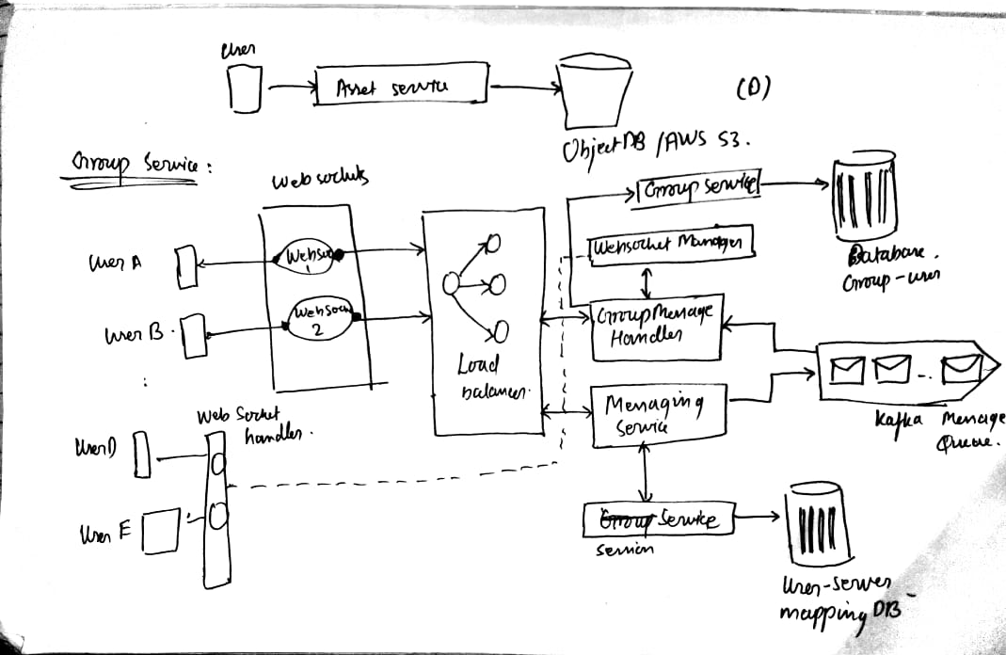
Group Chat Functionality

Slide 7
WebSocket handler doesn’t track groups it tracks users, therefore we need to maintain a database of GroupID and the Users present in the group.
Consider the following case:
Group 1 :{User A, User E , User D}
user A sends a message in the group1 ,the webSocket handler connects to message Service, which in this case stores the message in a queue. Message service here acts as a Kafka producer.
It then connects to Group Message Handler, which connects to Group service. The Group service maintains a database with list of GroupID and users in the group. It provides list of users the message has to be sent. It then goes to webSocket manager. The webSocket manager then carries out the task to send message to each user just in normal way.

Slide 8
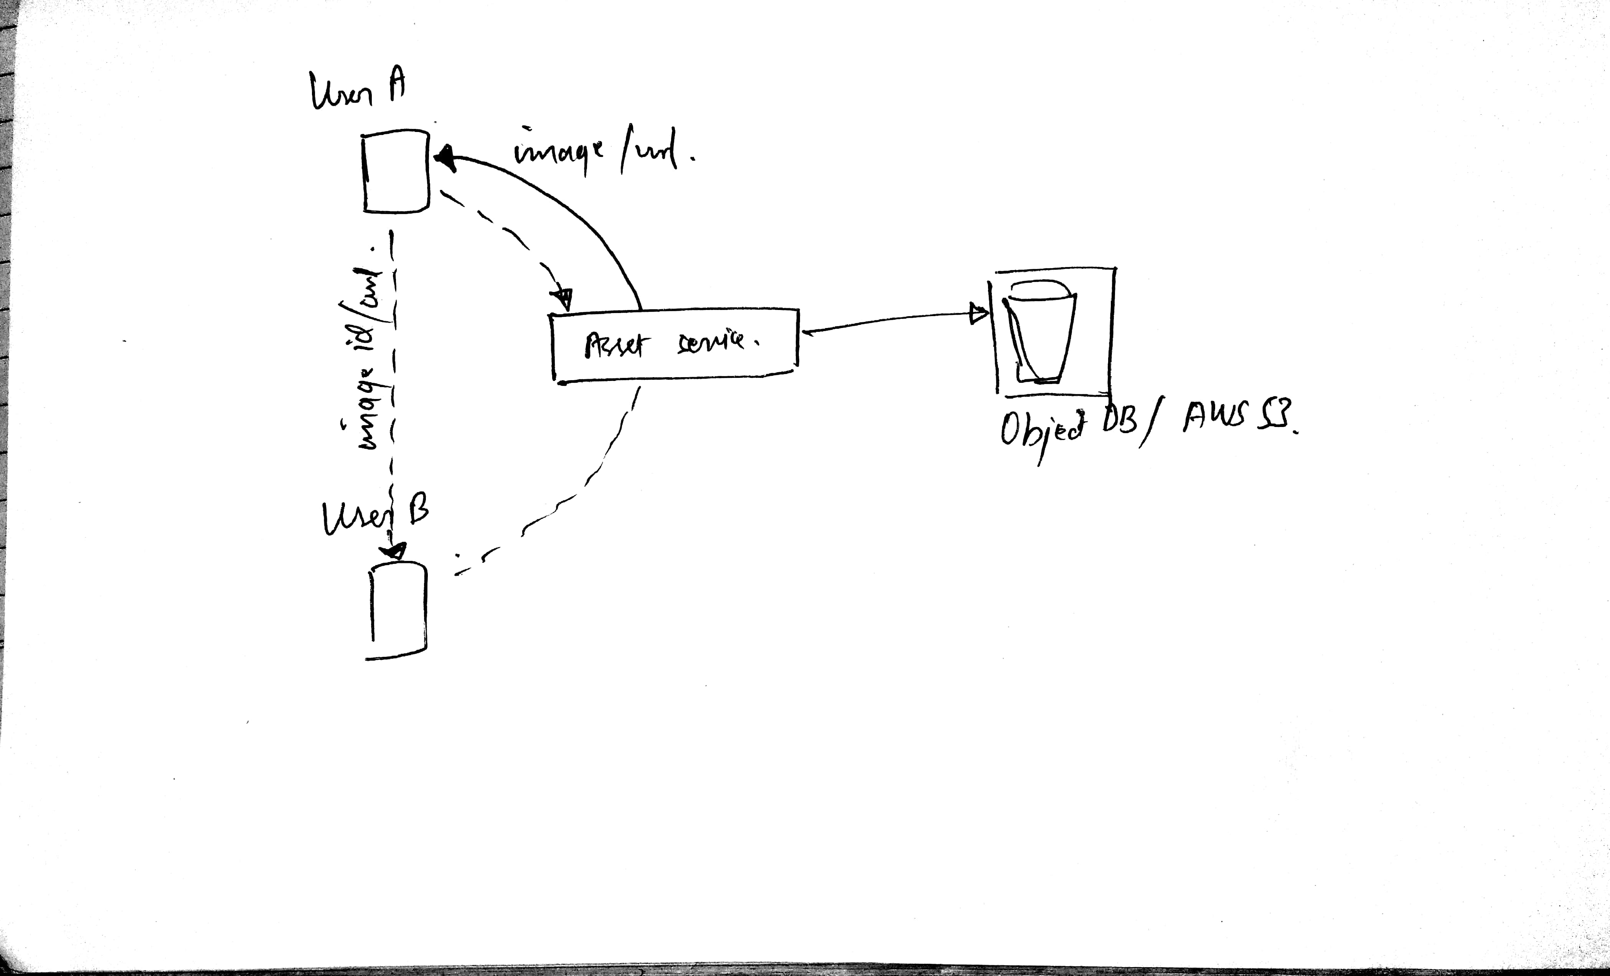
Asset Service(For managing media files)

Slide 9
Suppose User A sends some media message to User B.
The media is compressed and stored in Object database. An blob url is generated and sent to user B. Upon receiving the Url user B can access the data in the server.
Databases:
Except from chat databases, all other databases are relational, So an Sql database is used. Owing to large scalability we use MongoDB to store the data for Chat Services.

Slide 10
Deployment:
Build on MERN(MongoDB, Express JS, React Js, Node Js) Stack
Step 1: install Node JS and npm
Step 2: using npm “ use code npm install –g yarn” to install the yarn file
Step 3: using yarn add all the dependencies listed in Package.JSON in dependencies folder
Step 4: type command ‘npm start’ or ‘yarn start’ in terminal to start the project
Unfortunately, I have not been able to complete the Project till now. If you are reading this message You may not consider it for evaluation.
I am very sorry for the inconvenience caused.

Slide 11
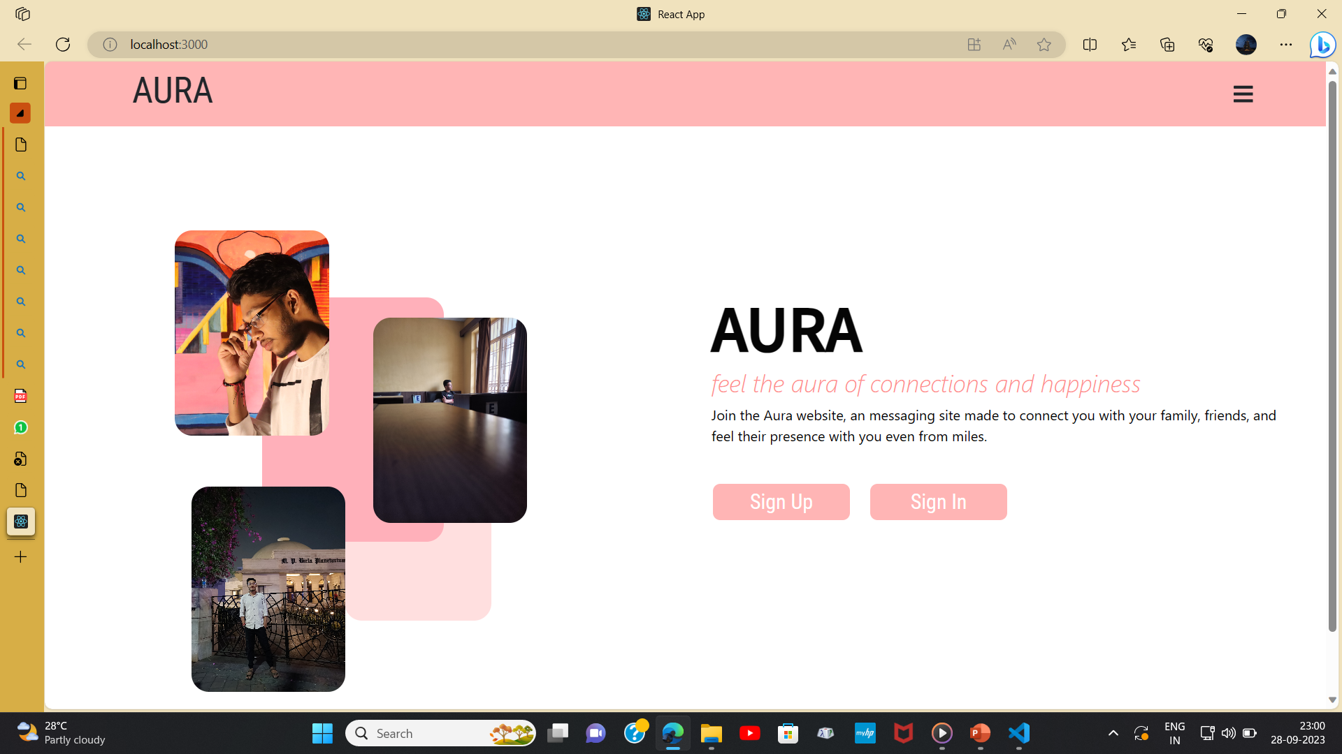
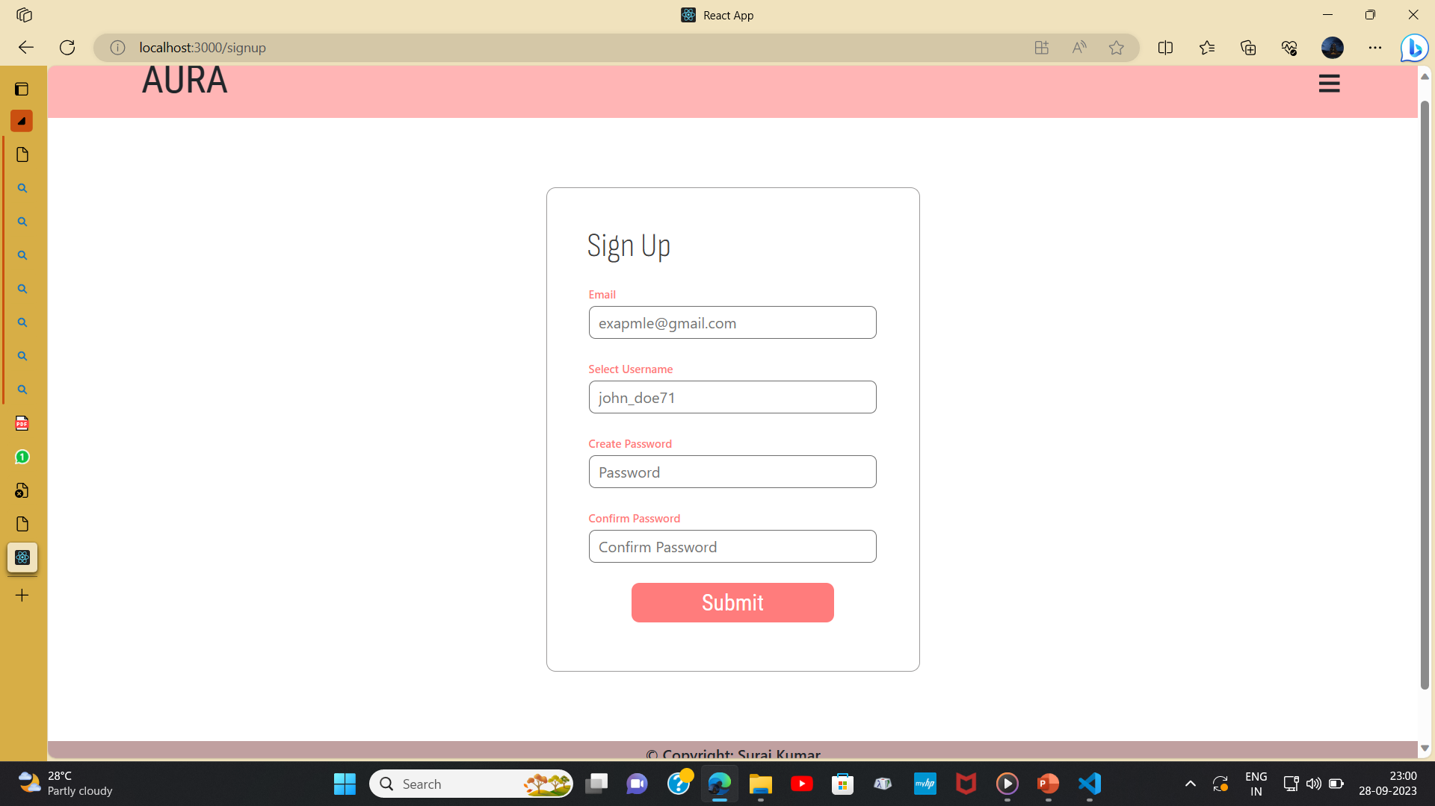
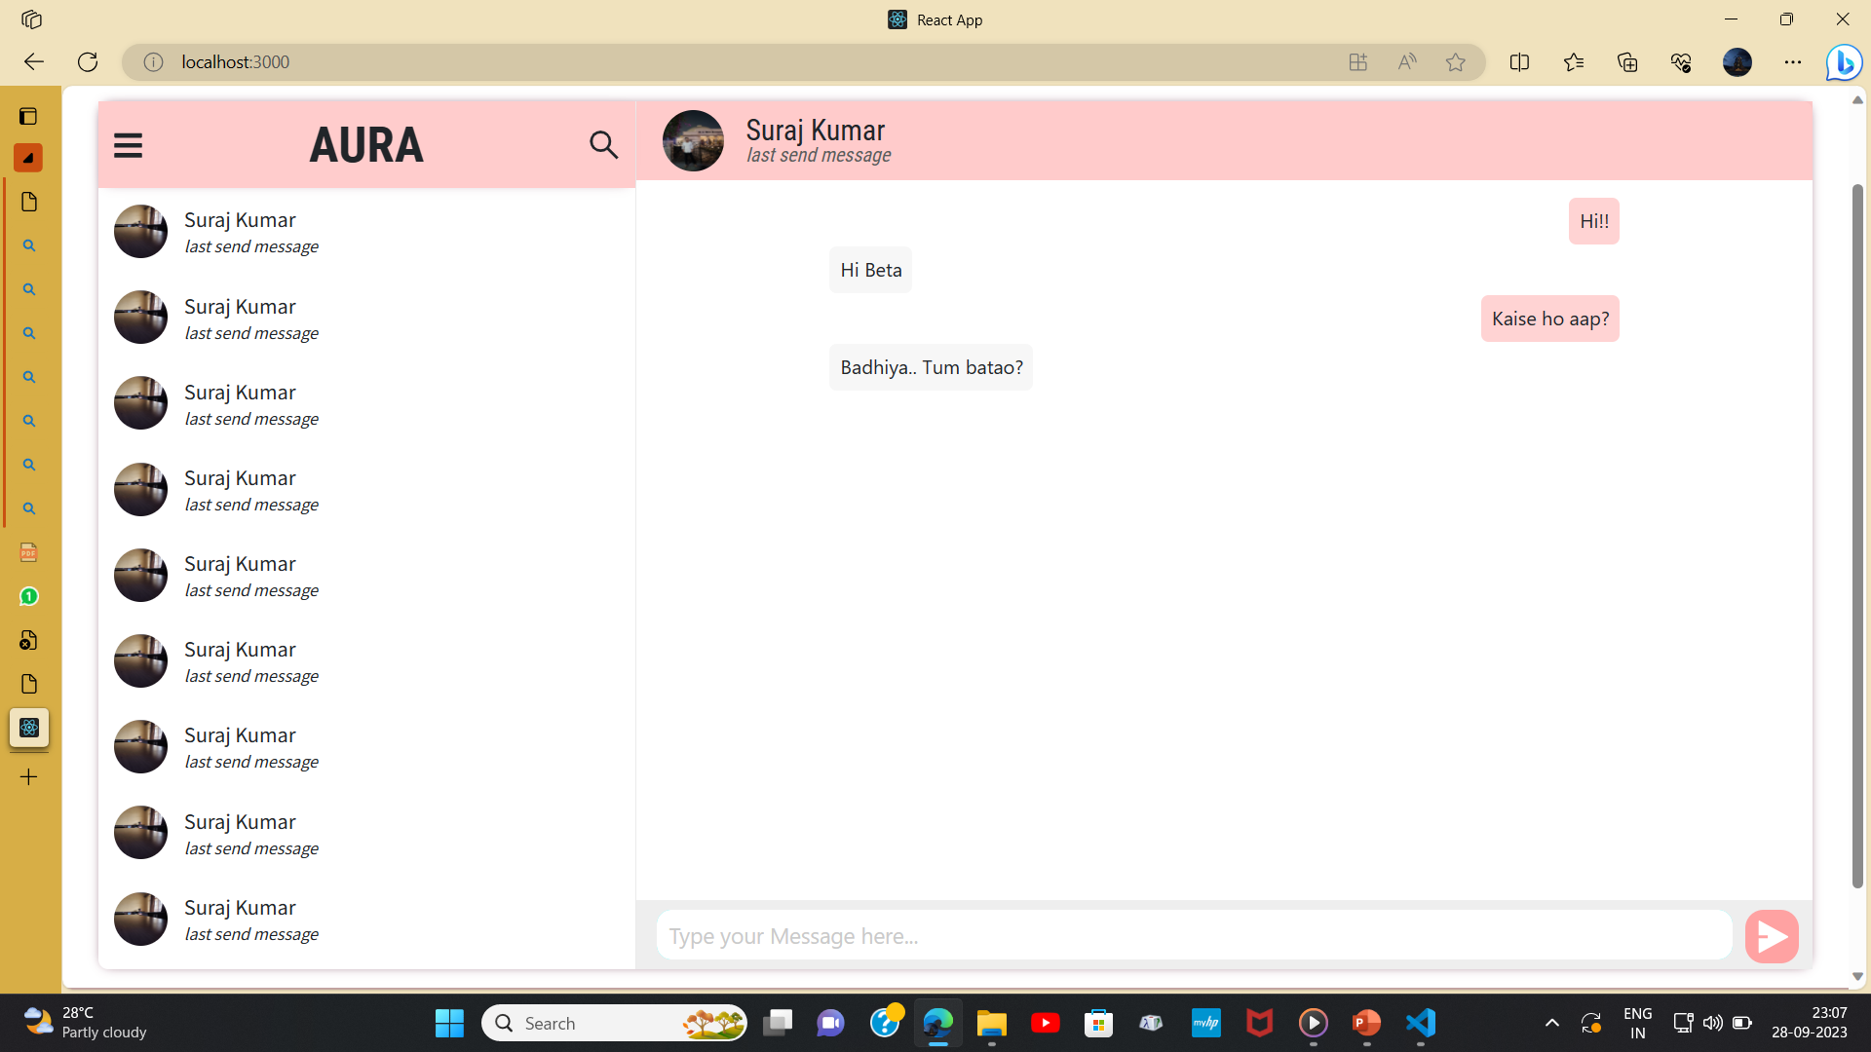
Some associated pages:

Slide 12
Created By:
Name: Suraj Kumar
Institute: IIT Dhanbad
Department: Software Engineer

